Slide 1
The Oscillating Control Hypothesis Reassessment in view of New Information from the Eastern Bering Sea
George L. Hunt, Jr.
School of Aquatic and Fishery Sciences
University of Washington
Lisa Eisner
Ed Farley
Jamal Moss
Jeffrey M. Napp
NOAA Alaska Fisheries Science Center

Slide 2
Where I want to go in this talk
Walleye Pollock one of USA’s most important Fisheries
Recently, big drop in pollock biomass in Eastern Bering Sea
Gap in production of strong year classes
What fuels production of young pollock?
Role of Sea Ice
Long-term consequences

Slide 3
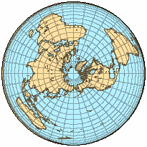
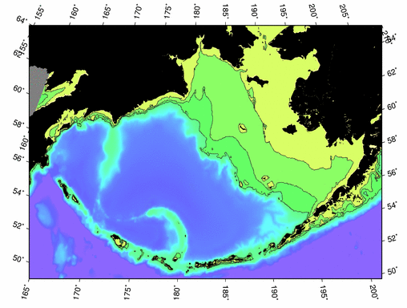
The Bering Sea
Russia
Chirikov
Basin
< 50 m
Anadyr
Basin
50-100 m
Cape Navarin
Alaska
100-200 m
Commander Basin
Aleutian
Basin (west)
Inner
Domain
Middle
Domain
Aleutian
Basin (east)
Outer
Domain
Modified from: Aydin et al. (2002) and Mueter unpbl

Slide 4
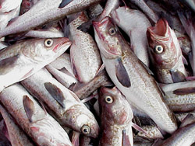
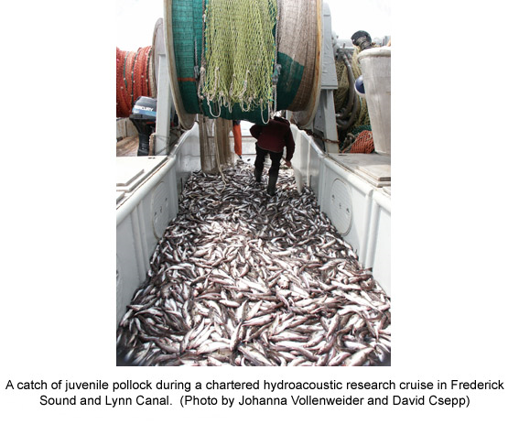
Importance of Walleye Pollock Fisheries
Number 1 species in USA by weight
2,298.1 million pounds; 28% of US fish catch
Value $323,212, 000
Dutch Harbor/Unalaska USA
Number 1 port for weight (612.7 million lb.)
Number 2 port for value ($195 million)
Source: NOAA Fisheries website

Slide 5
Pollock Modeled Biomass
Source: NPFMC 2010 SAFE, Dec 2009

Slide 6
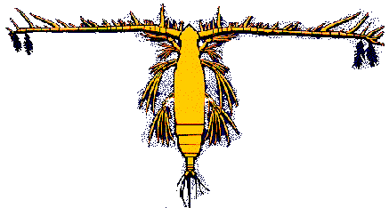
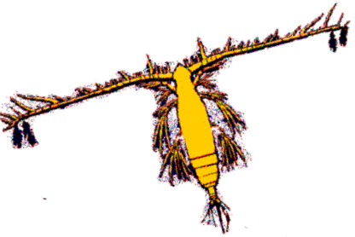
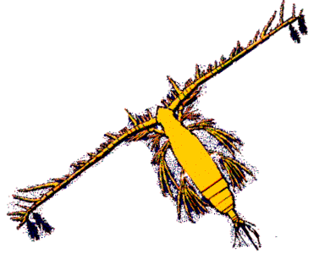
Ice, Wind, Bloom and Copepods
Early Ice Retreat Late Bloom, Warm Water – Large Copepod Biomass
Late Ice Retreat Early Bloom, Cold Water – Small Copepod Biomass
February
March
April
May
June
Hunt et al. 2002

Slide 7
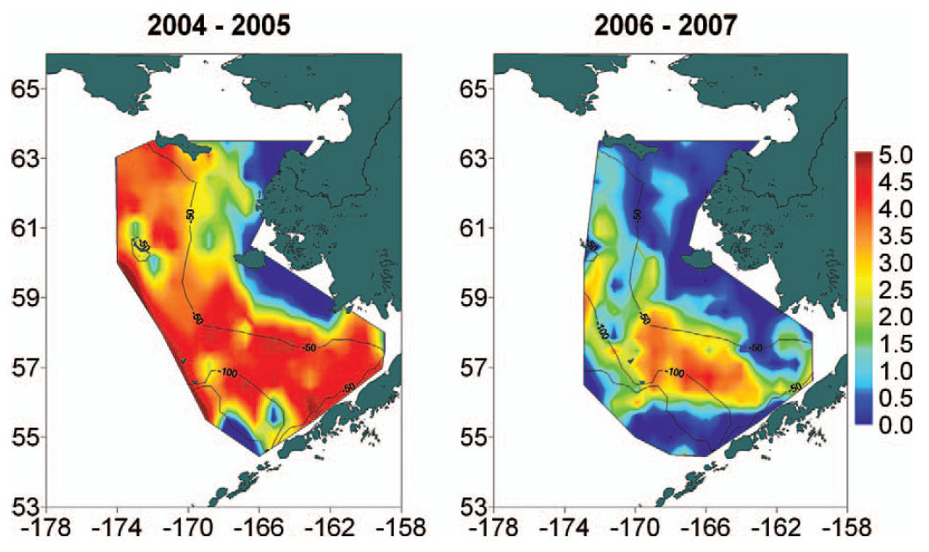
Distribution of Age-0 Walleye Pollock log_{e} transformed catch per unit effort (fish/m³)
Moss et al., 2009 Trans .Amer. Fish. Soc.

Slide 8
Year Class Strength Variable
Source: NPFMC 2010 SAFE, Dec 2009

Slide 9
What were the Assumptions?
Warm water good for copepod survival and growth
Euphausiids were always available
Warm water good for age-0 pollock feeding and growth
Fast growing age-0 pollock will have a greater survival to age-1

Slide 10
The Reality Check
The warm years did not lead to big year-classes of pollock
Baier and Napp 2003 showed that Calanus marshallae needed an early bloom in cold water
Perhaps warm years were good for small copepods but not for the big C. marshallae or for euphausiids
So- some bad assumptions! NEW DATA NEEDED

Slide 11
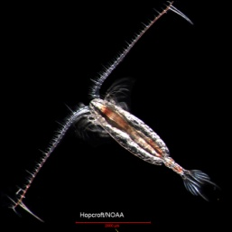
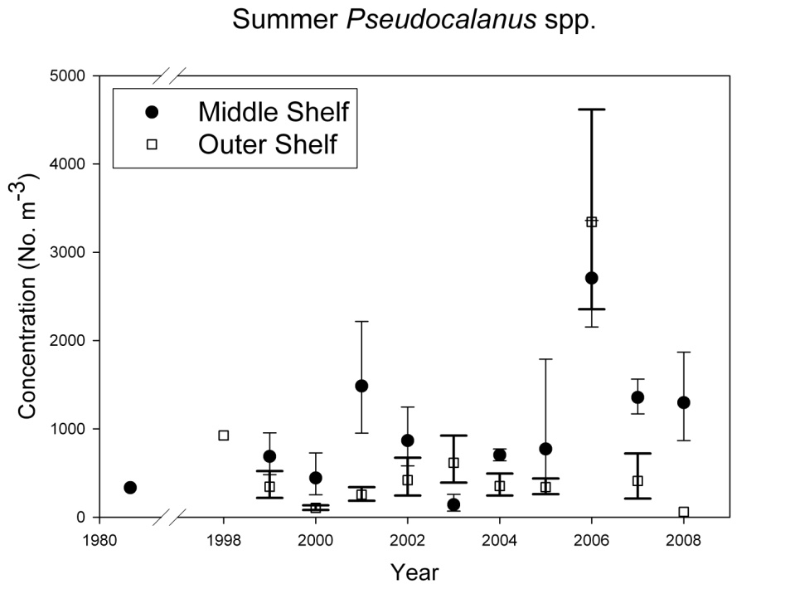
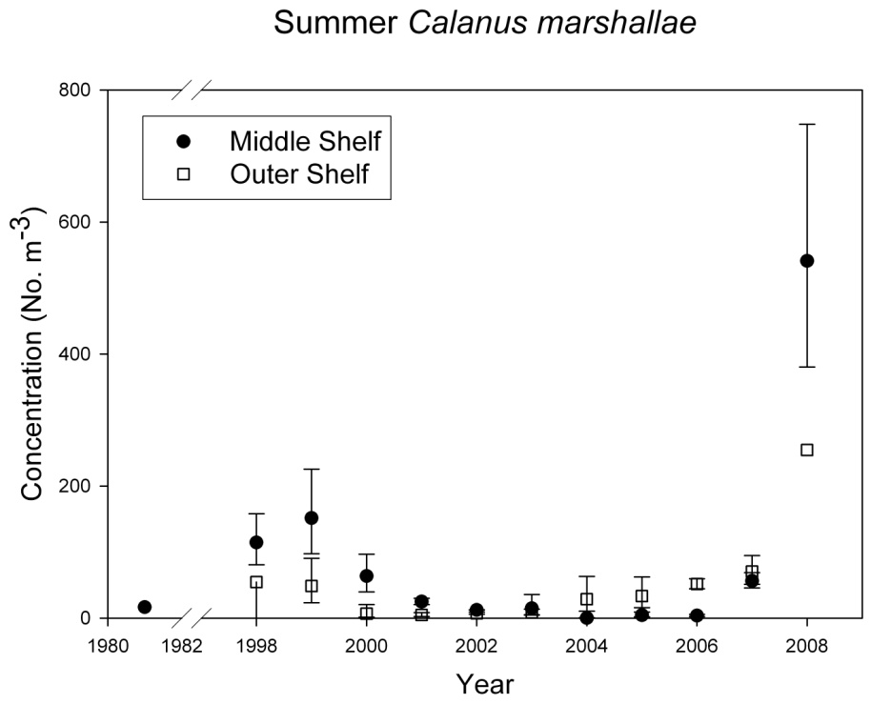
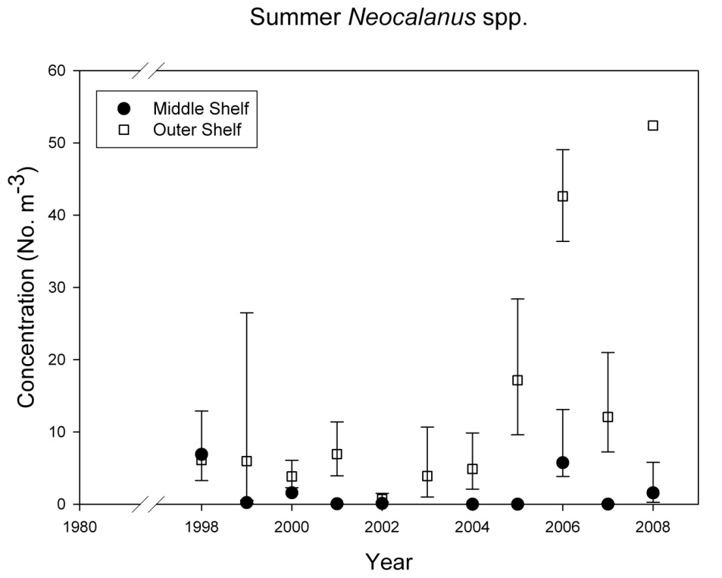
July Copepod Abundance
Figure Courtesy of J. Napp, NOAA AFSC

Slide 12
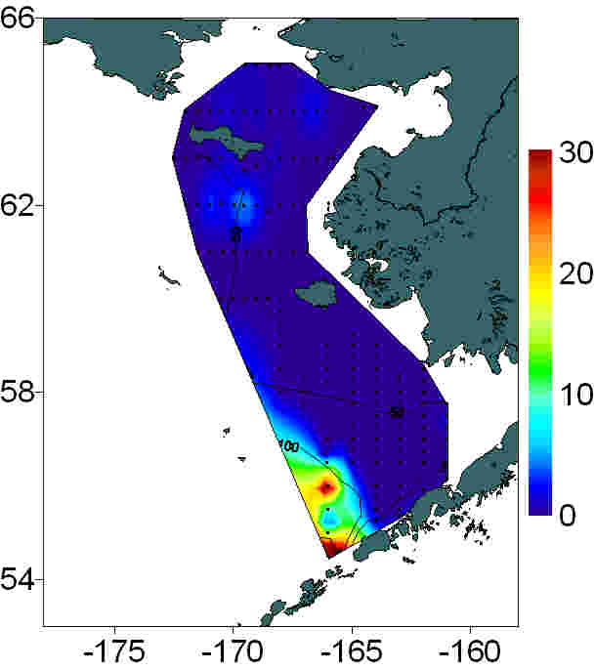
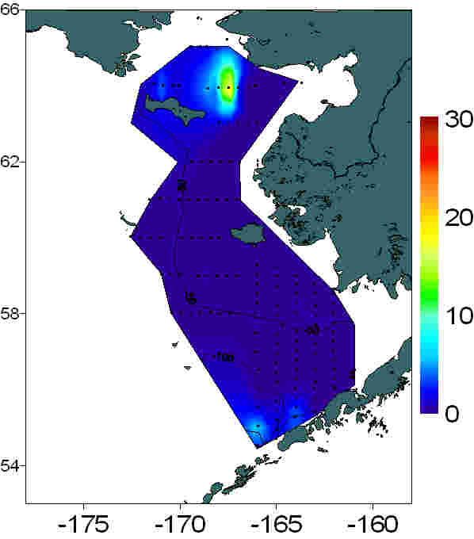
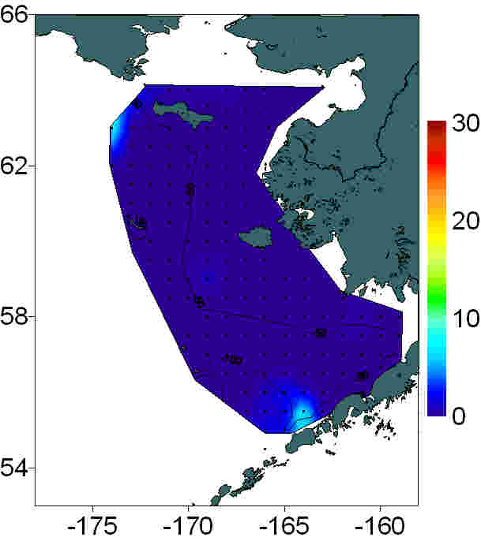
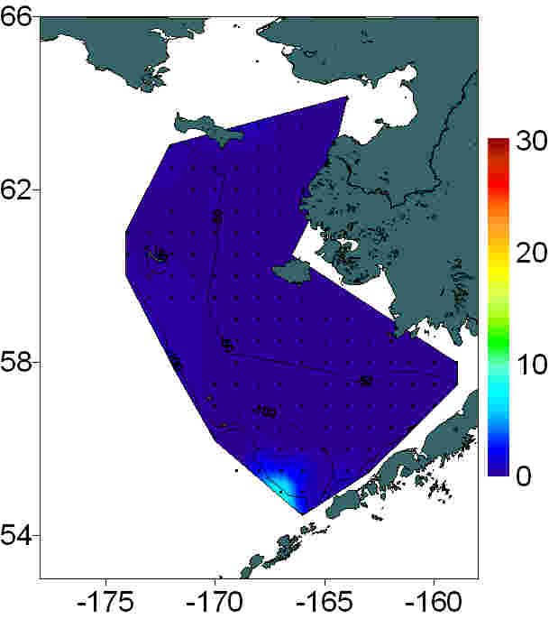
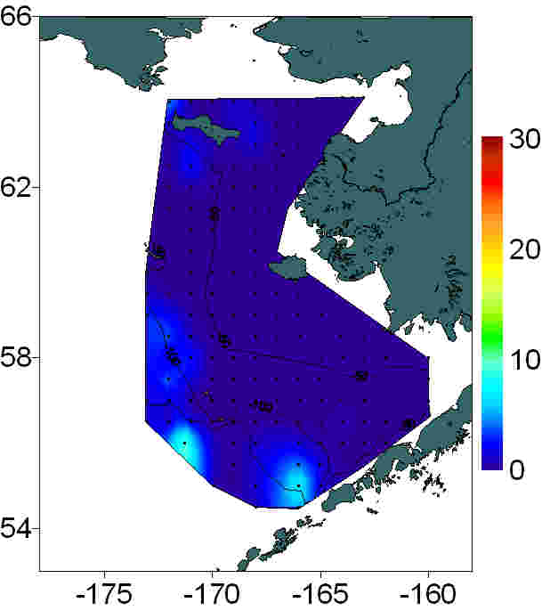
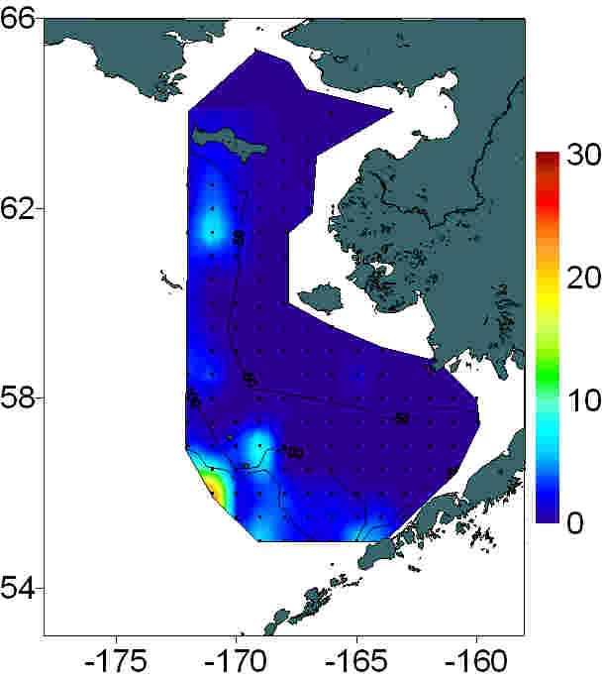
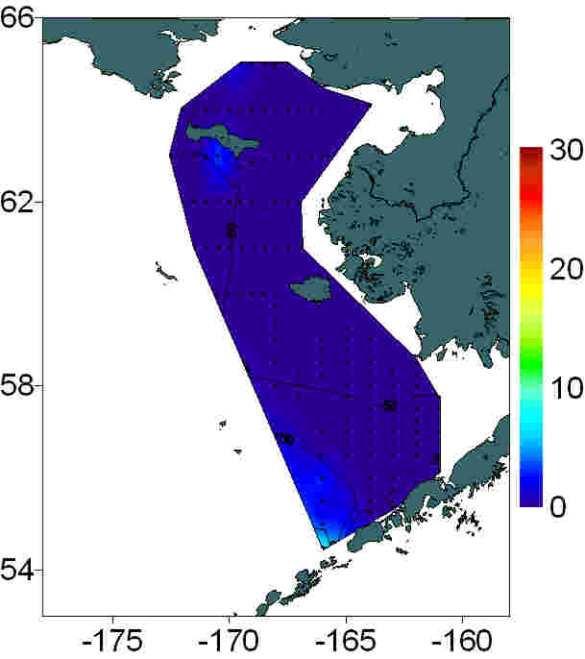
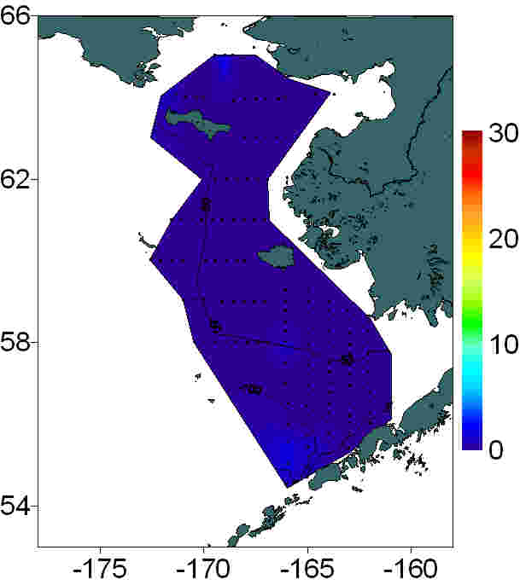
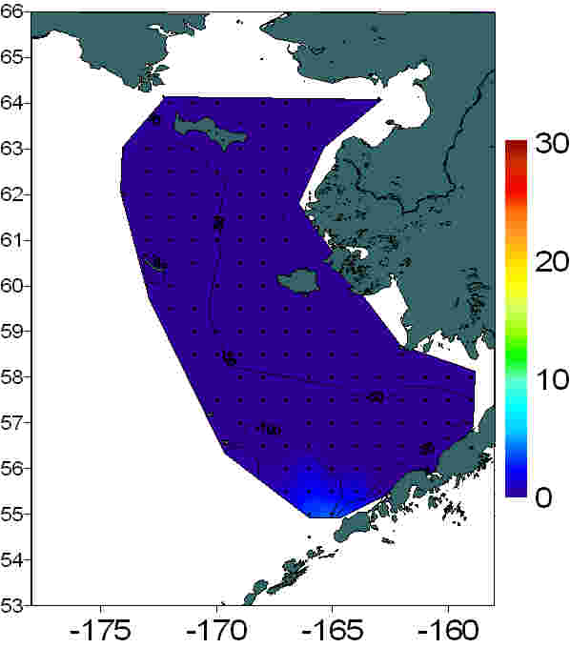
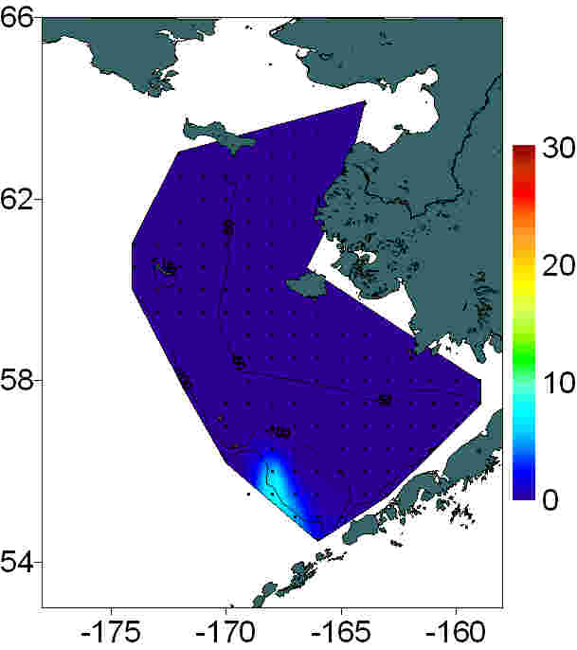
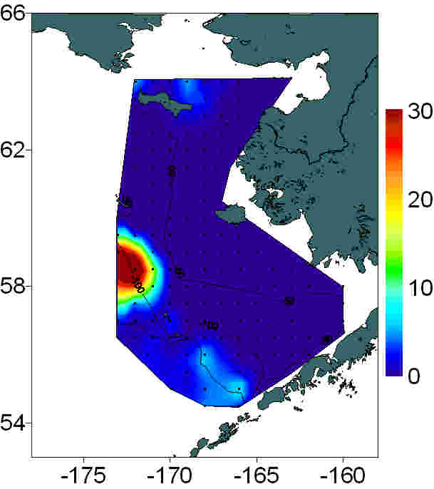
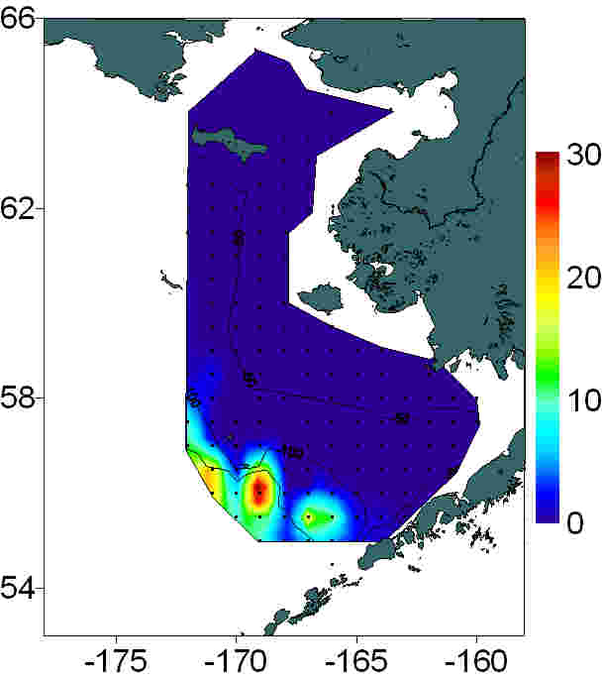
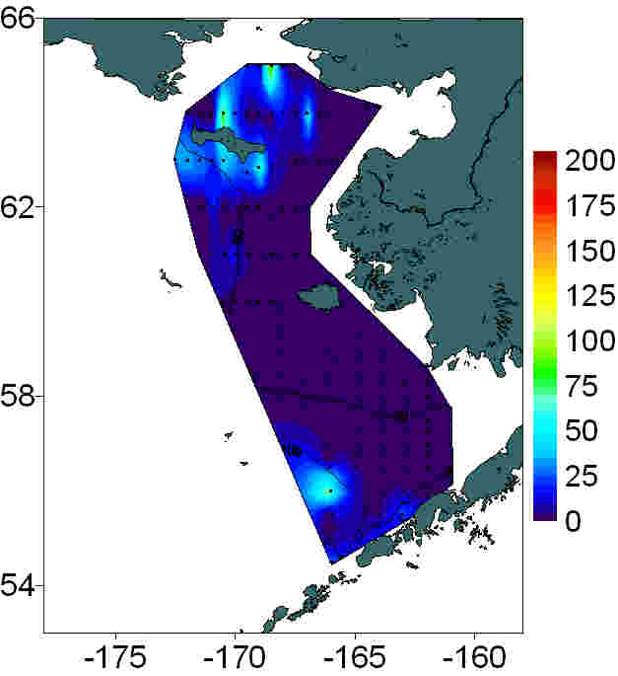
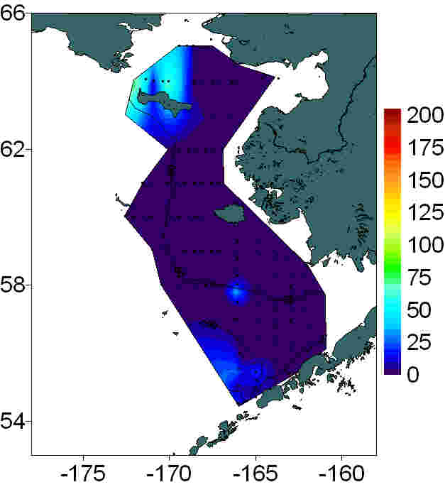
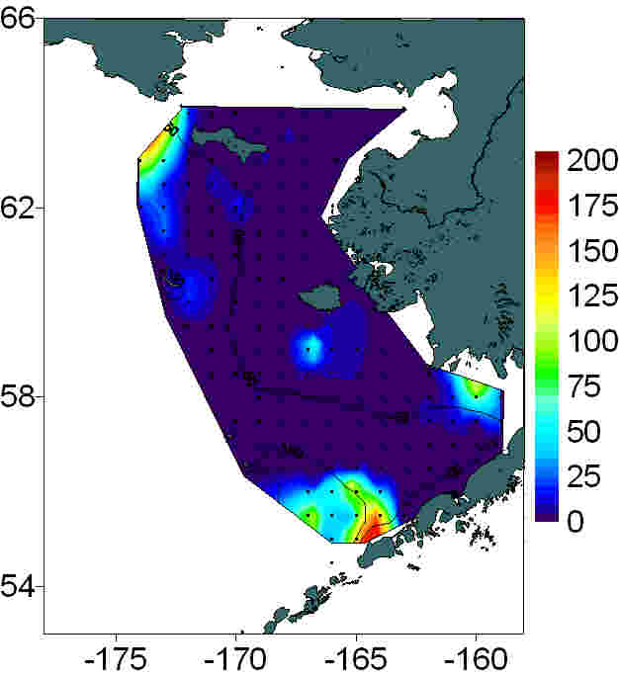
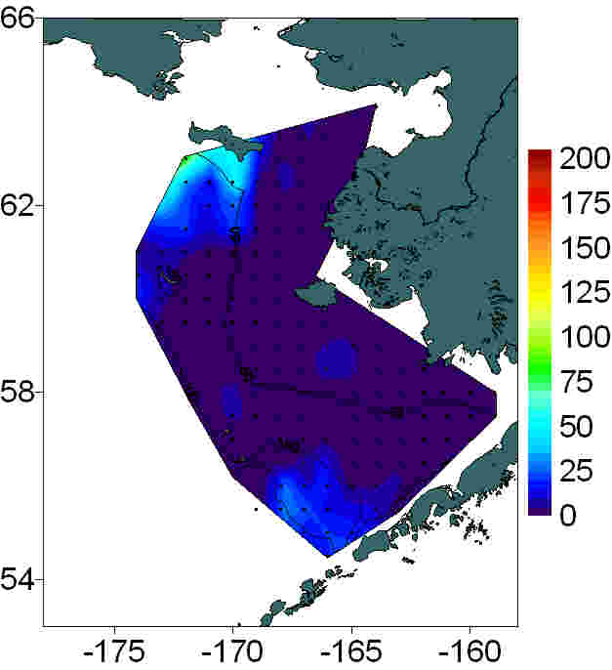
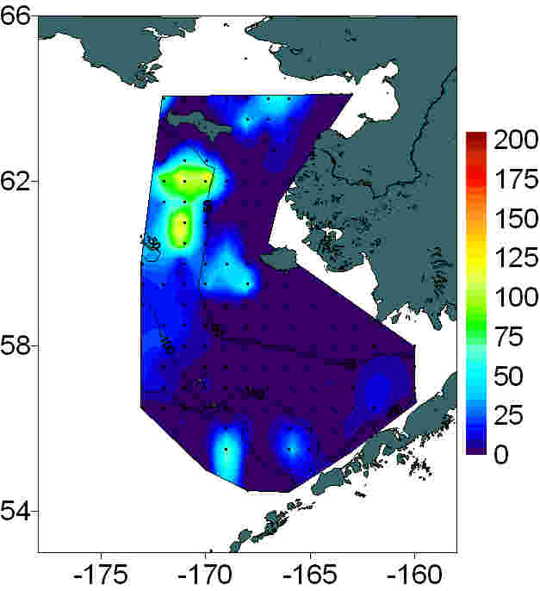
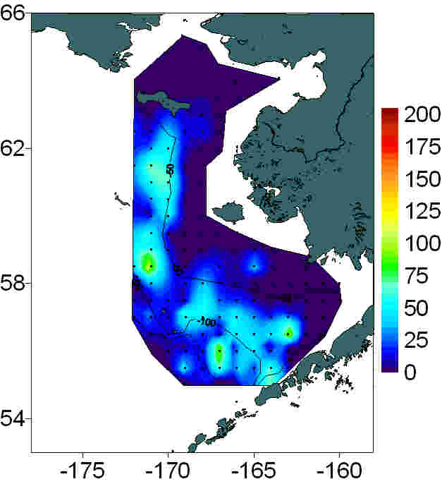
Large zooplankton abundance (# per m³), Bongo Tow, 505 μm mesh net
2002
2003
2004
2005
2006
2007
Hyperiids
Neocalanus plumchrus & flemingeri
Calanus marshallae

Slide 13
Ice, Wind, Bloom and Copepods
Early Ice Retreat Late Bloom, Warm Water – Mostly Small Copepods
Late Ice Retreat Early Bloom, Cold Water – Large Calanus favored
February
March
April
May
June
Modified from Hunt et al. 2002

Slide 14
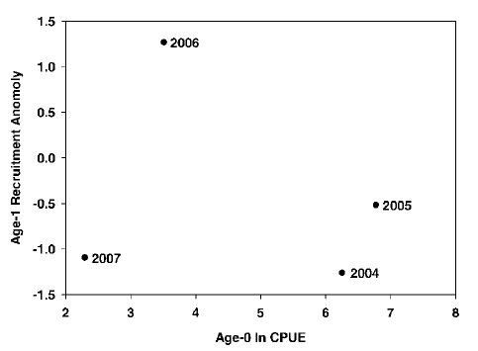
Abundance of Age-1 Pollock VS. Age-0 Abundance the prior year
From Moss et al., 2009

Slide 15
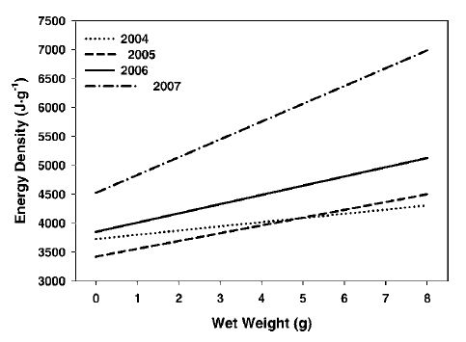
Age-0 Pollock Energy Density as a function of wet weight
From Moss et al., 2009

Slide 16
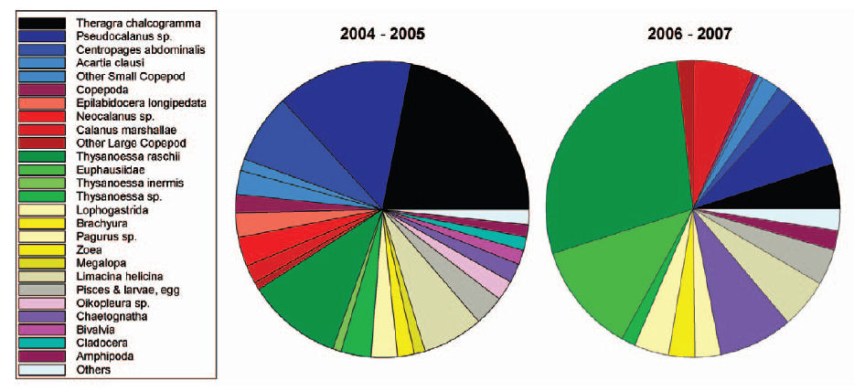
Diets of Age-0 Pollock in warm and cold years
From Moss et al., 2009

Slide 17
New Since 2002
Mueter- Pollock recruitment dome-shaped with respect to temperature
Moss et al.- Early pollock survival & growth better in warm years; growth weak in cold years
Baier & Napp- Need early bloom, cool water to have big zoops (C. marshallae, T. raschii)
Moss et al- Need sufficient energy to survive winter; size & energy density of age-0s critical
Predation on age-0 pollock greater when large zoops scarce in summer

Slide 18
Conclusions
Variations in timing of ice retreat affect the availability and size of copepods in spring- warm springs have mostly small copepods, but good early survival of age-0 pollock.
High numbers of age-0 pollock in summer do not necessarily lead to high numbers of age-1 pollock the next year
In warm years, there is a lack of large crustacean zooplankton in summer, age-0 pollock have low energy density, and there is enhanced cannibalism
In warm years, summer lack of large zooplankton may result from their failure to recruit in the spring

Slide 19
Impacts of Availability of Large Zoops
Warm year with late bloom and few large copepods or euphausiids
Cold year with early bloom and abundant large copepods and euphausiids
Mesozooplankton
Age-0s
Year 2 and older
Age-1s

Slide 20
Middle Shelf Copepods (No. m⁻³) August 1999 vs. 2004
Data Type (from Coyle et al. 2008) | 1999 (Cold) | 2004 (Warm) | P value
Oithona similis | 348 | 1633 | 0.000
Pseudocalanus spp. | 404 | 1211 | 0.000
Acartia spp. | 277 | 507 | 0.264
Centropagus abdominalis | 0 | (2.96)⁻⁰³ | 0.177
Calanus marshallae | 44 | (8.13)⁻⁰⁴ | 0.000
Calanoid nauplii | 161 | 2.69 | 0.015

Slide 21
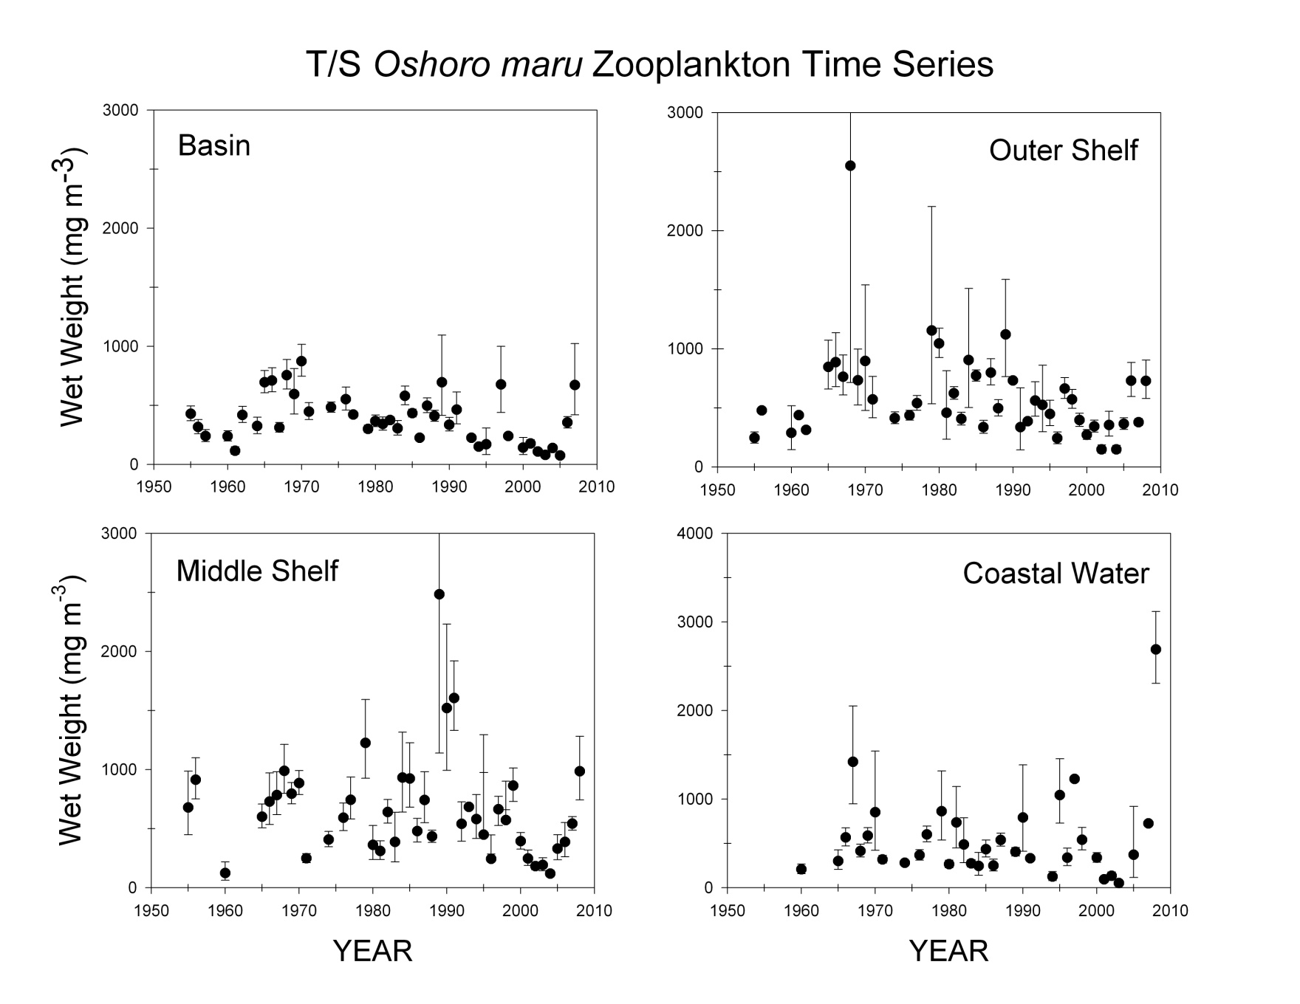
July Zooplankton Biomass
Figure courtesy of J. Napp / N. Shiga

